Slide 1
Read in and manipulate data
Pandas, NumPy, SciPy

Slide 2

More Pandas
- Series
- DataFrames
- Indexing, Selecting, Filtering
- Drop columns
- Handling missing Data
But first…

Slide 3
Series
A Series is a one-dimensional array-like object containing an array of data and an associated array of data labels. One can use any NumPy data type to assign to the Series
Creating a Series:
Import numpy as np
np.random.seed(1)
np.random.random(10)
series_1 = pd.Series(np.random.random(10))
print(series_1)
series_1.values
Whats seed doing?
One can get a NumPy array from the Series, by typing:

Slide 4
Reindexing
One can also get the indices of each element, by typing:
series_1.index.values
# One can also have a custom set of indices:
alphabet = ['a', 'b', 'c', 'd', 'e', 'f', 'g', 'h', 'i', 'j’]
series_2 = pd.Series(np.random.random(len(alphabet)), index=alphabet)
print(series_2)
>>
a 0.800745 b 0.968262 c 0.313424 d 0.692323 e 0.876389 f 0.894607 g 0.085044 h 0.039055 i 0.169830 j 0.878143

Slide 5
Reindexing
One can select only a subsample of the Series
series_1[[0, 1, 2]]
series_1[[1,3,4]]
series_2[['a','d','j']]

Slide 6
Arithmetic and function Mapping
You can also perform numerical expressions
Or find values greater than some value 'x'
series_1**2
series_1[1]**2
x = 0.5
series_1[(series_1 >= x) & (series_1 < 0.8)]
>> array([4.17022005e-01, 7.20324493e-01, 1.14374817e-04, 3.02332573e-01, 1.46755891e-01, 9.23385948e-02, 1.86260211e-01, 3.45560727e-01, 3.96767474e-01, 5.38816734e-01])

Slide 7
Arithmetic and function Mapping
You can apply functions to a column, and save it as a new Series
import sys
def exponentials(arr, basis=10.):
""”
Docstring – can include info on input, output, purpose, examples
"""
if isinstance(arr, list):
exp_arr = [basis**x for x in arr]
return exp_arr
elif isinstance(arr, np.ndarray) or isinstance(arr, pd.core.series.Series):
exp_arr = basis**arr
return exp_arr
else:
cmd = ">>>> `arr` is not a list nor a numpy array"
cmd +="\n>>>> Please give the correct type of object"
print(cmd)
sys.exit(1)

Slide 8
Arithmetic and function Mapping
You can also create a Series using a dictionary
labels_arr = ['foo', 'bar', 'baz']
data_arr = [100, 200, 300]
dict_1 = dict(zip(labels_arr, data_arr))
print(dict_1)
series_3 = pd.Series(dict_1)
series_3
>> {'foo': 100, 'bar': 200, 'baz': 300}
>>
foo 100 bar 200 baz 300 dtype: int64

Slide 9
Handling Missing Data
One of the most useful features of pandas is that it can handle missing data quite easily:
index = ['foo', 'bar', 'baz', 'qux’]
series_4 = pd.Series(dict_1, index=index)
print(series_4)
pd.isnull(series_4)
series_3 + series_4

Slide 10
Handling Missing Data
One of the most useful features of pandas is that it can handle missing data quite easily:
index = ['foo', 'bar', 'baz', 'qux’]
series_4 = pd.Series(dict_1, index=index)
print(series_4)
pd.isnull(series_4)
series_3 + series_4
>>
foo False bar False baz False qux True dtype: bool
>>
bar 400.0 baz 600.0 foo 200.0 qux NaN dtype: float64

Slide 11

Handling Missing Data
So using a Series is powerful, but DataFrames are probably what gets used the most since it represents a tabular data structure containing an ordered collection of columns and rows.

Slide 12
DataFrames
A DataFrame is a "tabular data structure" containing an ordered collection of columns. Each column can a have a different data type.
Row and column operations are treated roughly symmetrically. One can obtain a DataFrame from a normal dictionary, or by reading a file with columns and rows.
Creating a DataFrame:
data_1 = {'state' : ['VA', 'VA', 'VA', 'MD', 'MD'],
'year' : [2012, 2013, 2014, 2014, 2015],
'popu' : [5.0, 5.1, 5.2, 4.0, 4.1]}
df_1 = pd.DataFrame(data_1)
df_1
How will this dataframe look like?

Slide 13
DataFrames
A DataFrame is a "tabular data structure" containing an ordered collection of columns. Each column can a have a different data type.
Row and column operations are treated roughly symmetrically. One can obtain a DataFrame from a normal dictionary, or by reading a file with columns and rows.
Creating a DataFrame:
data_1 = {'state' : ['VA', 'VA', 'VA', 'MD', 'MD'],
'year' : [2012, 2013, 2014, 2014, 2015],
'popu' : [5.0, 5.1, 5.2, 4.0, 4.1]}
df_1 = pd.DataFrame(data_1)
df_1
This DataFrame has 4 rows and 3 columns by the name "pop", "state", and "year".

Slide 14
DataFrames
The way to access a DataFrame is quite similar to that of accessing a Series. To access a column, one writes the name of the column, as in the following example:
df_1['popu’]
df_1.popu
df_2 = pd.DataFrame(data_1, columns=['year', 'state', 'popu', 'unempl'])
df_2
df_2['state’]
df_2.iloc[1:4]
Same?
One can also handle missing data with DataFrames. Like Series, columns that are not present in the data are NaNs:
Just a reminder!

Slide 15
DataFrames
Editing a DataFrame is quite easy to do. One can assign a Series to a column of the DataFrame. If the Series is a list or an array, the length must match the DataFrame.
unempl = pd.Series([1.0, 2.0, 10.], index=[1,3,5])
unempl
df_2['unempl'] = unempl
df_2
df_2.unempl.isnull()
df_2.T
df_2[['year', 'unempl']]
What prints?
You can also transpose a DataFrame, i.e. switch rows by columns, and columns by rows
show only the 'year' and 'popu' columns

Slide 16
Dropping Entries
Let's say you only need a subsample of the table that you have, and you need to drop a column from the DataFrame.
Remember we have done something similar with subsets
You can do that by using the 'drop' option:
df_3 = df_2.drop('unempl', axis=1)
df_3
df_2.drop('unempl', axis=1)
df_2

Slide 17
Dropping Entries
Let's say you only need a subsample of the table that you have, and you need to drop a column from the DataFrame.
Remember we have done something similar with subsets
You can do that by using the 'drop' option:
df_3 = df_2.drop('unempl', axis=1)
df_3
df_2.drop('unempl', axis=1)
df_2
df_4 = df_2.drop([1,2])
df_4
axis = {0 or ‘index’, 1 or ‘columns’}, default 0, Whether to drop labels from the index (0 or ‘index’) or columns (1 or ‘columns’).
I can chose to store the original or not
You can also drop certain rows

Slide 18
Dropping Entries
Let's say you only need a subsample of the table that you have, and you need to drop a column from the DataFrame.
Remember we have done something similar with subsets
You can do that by using the 'drop' option:
df_4 = df_2.drop([1,2])
df_4
year state popu unempl
0 2012 VA5.0 NaN
3 2014 MD4.0 2.0
4 2015 MD4.1 NaN
>>
Look at this carefully, what possible issue is there?

Slide 19
Dropping Entries
Let's say you only need a subsample of the table that you have, and you need to drop a column from the DataFrame.
Remember we have done something similar with subsets
You can do that by using the 'drop' option:
df_4 = df_2.drop([1,2])
df_4
df_4.reset_index(inplace=True)
df_4
year state popu unempl
0 2012 VA5.0 NaN
3 2014 MD4.0 2.0
4 2015 MD4.1 NaN
>>
Look at this carefully, what possible issue is there?
The DataFrame preserved the same indices as for df_2.
If you can to reset the indices, you can do that by:

Slide 20
Gaia Dataset
Pandas is great at reading Data tables and CSV files, and other kinds of documents. We will be using the Gaia's DR1 catalogue.
import pandas as pd
# Path to online file
url_path = 'http://cdn.gea.esac.esa.int/Gaia/gdr2/gaia_source/csv/GaiaSource_1000172165251650944_1000424567594791808.csv.gz'
# Converting data to DataFrame
gaia_df = pd.read_csv(url_path, compression='gzip’)
gaia_df.head()

Slide 21
Shape, Columns and Rows
You can get the shape of the "gaia_df" DataFrame by typing:
To get an array of the columns available, one could write:
That means there are 14209 rows and 94 columns.
gaia_df.shape
gaia_df.columns.values.sort()
gaia_df.columns.values
>> (14209, 94)

Slide 22
Shape, Columns and Rows - Practice
Let's say you only want a DataFrame with the the colums:
‘ ra’ (right ascension)
‘dec’ (declination)
‘l’ (galactic longitude)
‘b’ (galactic latitude)
Select the columns and show the first 15 rows:

Slide 23
Shape, Columns and Rows - Practice
Let's say you only want a DataFrame with the the colums:
‘ ra’ (right ascension)
‘dec’ (declination)
‘l’ (galactic longitude)
‘b’ (galactic latitude)
You do this by:
gaia_df_2 = gaia_df.loc[:,['ra','dec','l','b']]
# Displaying the first 15 lines
gaia_df_2.head(15)

Slide 24
Shape, Columns and Rows
You can also select only a subsample of the rows as well, as in the following example. Let's say I just want a random subsample of 10% of the galaxies in the Gaia DR1 catalogue.
Try:
import random
random.sample
import random
# Number of rows
nrows = len(gaia_df_2)
# Randomly selecting `nrows` from `gaia_df_2`
gaia_df_3 = gaia_df_2.sample(nrows)
gaia_df_3.shape

Slide 25
Shape, Columns and Rows
Lets re-normalizing the indices of this DataFrame
Remember we can always check the documentation:
drop bool, default FalseDo not try to insert index into dataframe columns. This resets the index to the default integer index.
inplace bool, default FalseWhether to modify the DataFrame rather than creating a new one.
gaia_df_3.reset_index(inplace=True, drop=True)
gaia_df_3

Slide 26
Shape, Columns and Rows
You can produce plots directly from the DataFrame!
title_txt = 'Right Ascension and Declination for Gaia'
gaia_df_3.plot('ra','dec', # Columns to plot
kind='scatter', # Kind of plot. In this case, it's `scatter`
label='Gaia', # Label of the points
title=title_txt, # Title of the figure
color='#4c72b0', # Color of the points
figsize=(12,8)) # Size of the fiure
import seaborn as sns
sns.pairplot(gaia_df_3, plot_kws={'color': '#4c72b0'}, diag_kws={'color': '#4c72b0’})
sns.jointplot(gaia_df_3['l'], gaia_df_3['b'], color='#3c8f40')
More on this later
Scatterplot Matrices

Slide 27
Indexing, Selecting, Filtering Data
Now I want to filter the data based on ra and dec:
I want to select all the stars within:
45 < RA < 50
5 < Dec < 10
Normally, you would could do in numpy using the np.where function
ra_arr = gaia_df.ra.values
dec_arr = gaia_df.dec.values
# Just showing the first 25 elements
np.column_stack((ra_arr, dec_arr))[0:25]

Slide 28
Indexing, Selecting, Filtering Data
## Numpy way of finding the stars that meet the criteria
ra_min, ra_max = (102, 104)
dec_min, dec_max = (56.4, 56.7)
# RA critera
ra_idx = np.where((ra_arr >= ra_min) & (ra_arr <= ra_max))[0]
# Dec criteria
dec_idx = np.where((dec_arr >= dec_min) & (dec_arr <= dec_max))[0]
# Finding `intersecting' indices that meet both criteria
radec_idx = np.intersect1d(ra_idx, dec_idx)
# Selecting the values from only those indices
ra_new = ra_arr[radec_idx]
dec_new = dec_arr[radec_idx]
# Printing out ra and dec for corresponding indices
print(np.column_stack((ra_new, dec_new)))

Slide 29
Indexing, Selecting, Filtering Data
The numpy way is rather convoluted and long, and one can easily make a mistake if s/he doesn't keep track of which arrays s/he is using!
In Pandas, this is much easier!!
gaia_df_4 = gaia_df.loc[(
(gaia_df.ra >= ra_min) & (gaia_df.ra <= ra_max) &
(gaia_df.dec >= dec_min) & (gaia_df.dec <= dec_max))]
gaia_df_4[['ra','dec']]

Slide 30
break

Slide 31
Read in and manipulate data Plotting —line data, histograms, images.
Generating (and plotting) data Planck + density profile

Slide 32
There are lots of modules to read in data from a file
— try numpy modules genfromtxt or loadtxt
import numpy as np
help(np.genfromtxt)
x1,y1 = np.genfromtxt('dataset1.txt',unpack=True,)
# that was it!
# we use unpack to tell python to throw out the two columns and we caught them with arrays x and y # but we could have just captured whatever came out, then it just would be a merged array:
data = np.genfromtxt('dataset1.txt',dtype=np.float)
print (data)
print (data.shape) print data[:,0]
x1
np.array_equal(x1,
data[:,0])
# another nice thing, genfromtxt will read data from a URL! What?!
A = np.genfromtxt('https://raw.githubusercontent.com/jbrownlee/Datasets/master/ pima-indians-diabetes.data.csv',unpack=True, delimiter=',')
read in the data, and save it to two arrays, i.e. x1 and y1:

Slide 33
Fitting a straight line
# let’s fit our x and y data with a straight line, first define a line function:
def myline(x,m,b): return m*x+b
# now let's grab a function that performs a least-squares curve fit from the
# scipy.optimize package:
from scipy.optimize import curve_fit help(curve_fit)
bestfit, covar_mat = curve_fit(myline, x1, y1, p0 = [1.0,1.0]) print(bestfit)
# and overplot the best-fit:
import matplotlib.pyplot as plt
plt.plot(x1,myline(x1,bestfit[0],bestfit[1]),’k:') plt.xlim((-1,21)) # limit the X range of our plot
# make a better sampled plot of our best fit line with a thicker line:
x_fit = np.arange(0, 20, 0.5)
plt.plot(x_fit, myline(x_fit, bestfit[0], bestfit[1]), ’k--', lw=2)
# always add axis labels! plt.xlabel(‘Xvalue') plt.ylabel(‘Yvalue')
More on SciPy later
print("Best-fit parameters: m = {0} and b = {1}".format(*bestfit))

Slide 34
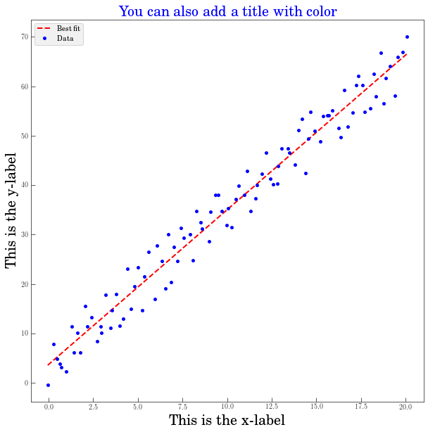
Fitting a straight line

Slide 35
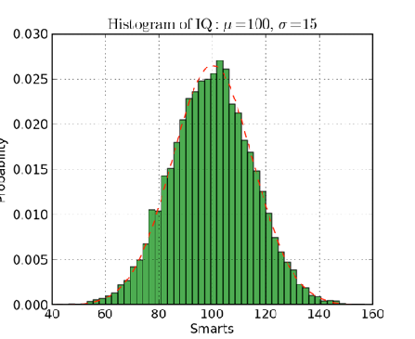
Let’s PRACTICE slightly more complicated plots
## Importing modules
import numpy as np
import scipy
import matplotlib.pyplot as plt
# Mean and standard deviation
mu, sigma = 100, 15
# Array of random values
x = mu + (sigma * np.random.randn(10000))
# Function for the PDF of distribution
def normpdf(x, mu, sigma):
u = (x-mu)/np.abs(sigma)
y = (1/(np.sqrt(2*np.pi)*np.abs(sigma)))*np.exp(-u*u/2)
return y

Slide 36
Let’s PRACTICE slightly more complicated plots
# Initialize figure
fig = plt.figure(figsize=(8,8))
ax = fig.add_subplot(111, facecolor='white')
# Creating histogram
# Normalized PDF
# Adding labels and title
# Setting up axis
# Adding a grid
# Adding legend

Slide 37
Solution-Let’s practice slightly more complicated plots
# Initialize figure
fig = plt.figure(figsize=(8,8))
ax = fig.add_subplot(111, facecolor='white')
# Creating histogram
n, bins, patches = plt.hist(x,
bins=50,
density=True,
histtype='stepfilled',
facecolor='green',
alpha=0.75,
label='Normal distr.')
# Normalized PDF
# Adding labels and title
# Setting up axis
# Adding a grid
# Adding legend

Slide 38
Solution-Let’s practice slightly more complicated plots
# Initialize figure
fig = plt.figure(figsize=(8,8))
ax = fig.add_subplot(111, facecolor='white')
# Creating histogram
n, bins, patches = plt.hist(x,
bins=50,
density=True,
histtype='stepfilled',
facecolor='green',
alpha=0.75,
label='Normal distr.')
# Normalized PDF
y_pdf = normpdf(x, mu, sigma)
plt.plot(x, y_pdf, 'ro', linestyle='', label='PDF')
# Adding labels and title
# Setting up axis
# Adding a grid
# Adding legend

Slide 39
Solution-Let’s practice slightly more complicated plots
# Initialize figure
fig = plt.figure(figsize=(8,8))
ax = fig.add_subplot(111, facecolor='white')
# Creating histogram
n, bins, patches = plt.hist(x,
bins=50,
density=True,
histtype='stepfilled',
facecolor='green',
alpha=0.75,
label='Normal distr.')
# Normalized PDF
y_pdf = normpdf(x, mu, sigma)
plt.plot(x, y_pdf, 'ro', linestyle='', label='PDF')
# Adding labels and title
plt.title(r'Histogram of IQ: $\mu = %s, \sigma = %s$' %(mu, sigma), fontsize=20)
# Setting up axis
plt.axis([40, 160, 0, 0.03])
# Adding a grid
plt.grid(True)
# Adding legend
plt.legend(loc='best', prop={'size': 15})

Slide 40
How do we know the possible options for hist (or any python command?)
matplotlib.pyplot.hist(x, bins=10, range=None, normed=False, weights=None, cumulative=False, bottom=None, histtype='bar', align='mid', orientation='vertical', rwidth=None, log=False, color=None, label=None, hold=None, **kwargs)
Call signature:
hist(x, bins=10, range=None, normed=False, weights=None, cumulative=False, bottom=None, histtype='bar', align='mid', orientation='vertical', rwidth=None, log=False,
color=None, label=None,
**kwargs)
look for the documentation from the imported library -- here it’s
http://matplotlib.sourceforge.net/index.html

Slide 41
In class practice:
Let’s make your own python script!
Write a script that will generate a file containing the Planck spectrum (wavelength and Intensity at that wavelength for many wavelengths)

Slide 42
Create an equation in Python syntax such that for temperature T=300 K, and wavelength lambda = 1cm, it finds the Intensity of a Planck spectrum.
First, write this equation in python script:
2hc² 1
_{Z}5 _{e}hc/ZkT
I =
1.0

Slide 43


Create an equation in Python syntax such that for temperature T=300 K, and wavelength lambda = 1cm, it finds the Intensity of a Planck spectrum.
2hc² 1
_{Z}5 _{e}hc/ZkT
I =
1.0
intensity= ((2*h*c**2)/wavelen**5)* (1.0/ (e**((h*c)/(wavelen*k*T) -1.0)
have to define these constants ahead of time

Slide 44
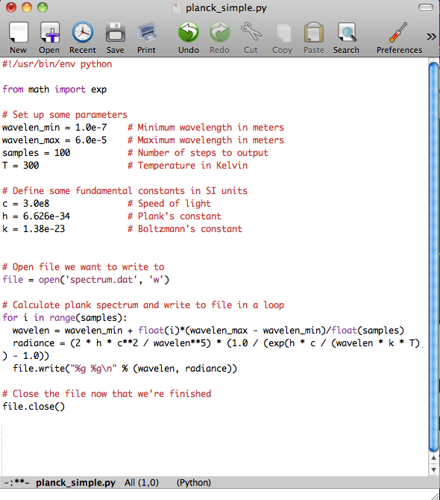
In class practice:
Simple version:
Try using functions!

Slide 45
In class practice:
import math
def planck_intensity(temperature, wavelength):
h = 6.626e-34 # Planck's constant in J*s
c = 3.0e8 # Speed of light in m/s
k = 1.38e-23 # Boltzmann constant in J/K
wavelength_m = wavelength * 1e-2 # Convert wavelength from cm to m
exponent = h * c / (wavelength_m * k * temperature)
intensity = (2 * h * c**2) / (wavelength_m**5) * (1 / (math.e**exponent - 1))
return intensity
temperature = 300 # Temperature in Kelvin
wavelength = 1 # Wavelength in cm
intensity = planck_intensity(temperature, wavelength)
print(f"The intensity of the Planck spectrum at {temperature} K and {wavelength} cm wavelength is: {intensity} W/m^2/sr")
## bonus- save the output!

Slide 46
In class practice:
Full results on jupyter notebook file

Slide 47
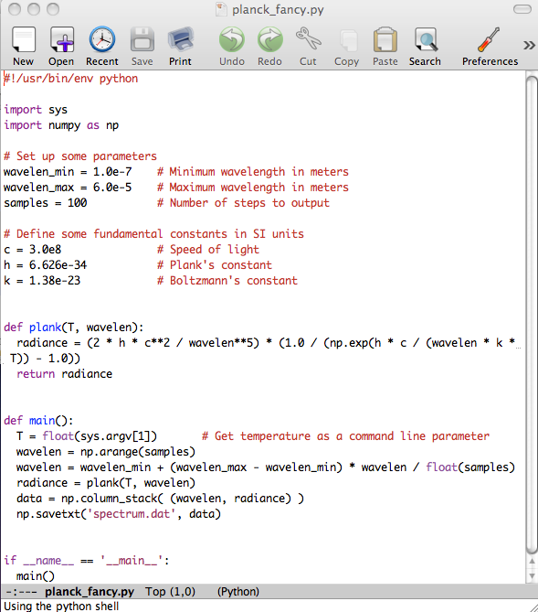
In class practice:
Fancy version:

Slide 48
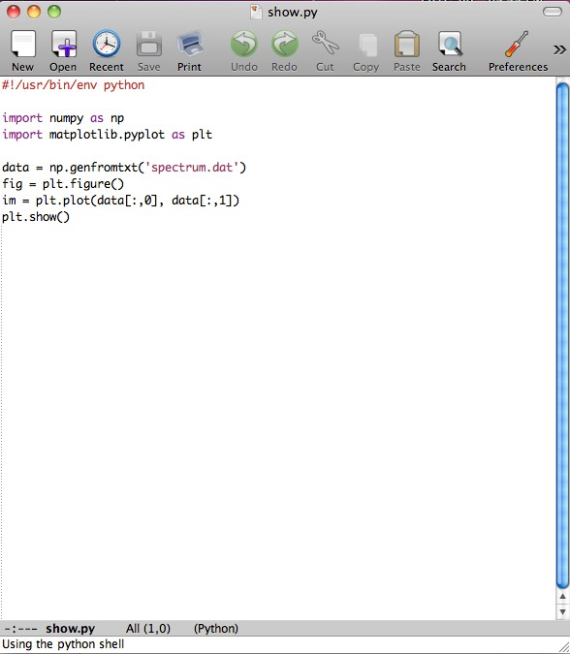
In class practice:
Now let’s plot the data!

Slide 49
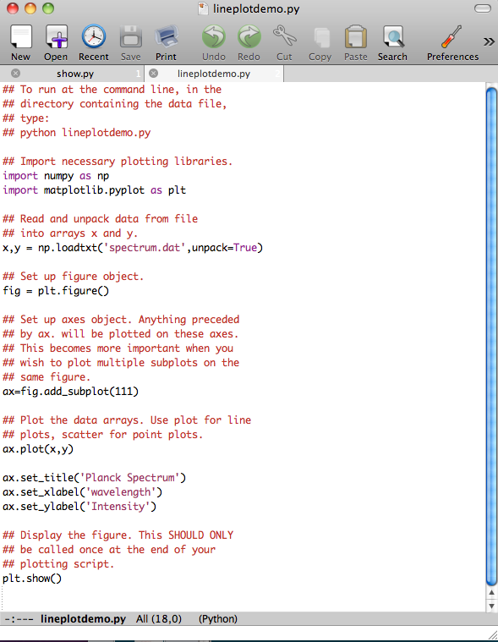
In class practice:
Now let’s plot the data (and add axes, titles, all that good stuff)...

Slide 50
import numpy as np
import matplotlib.pyplot as plt
import math
def planck_intensity(temperature, wavelength):
h = 6.626e-34 # Planck's constant in J*s
c = 3.0e8 # Speed of light in m/s
k = 1.38e-23 # Boltzmann constant in J/K
wavelength_m = wavelength * 1e-2 # Convert wavelength from cm to m
exponent = h * c / (wavelength_m * k * temperature)
intensity = (2 * h * c**2) / (wavelength_m**5) * (1 / (math.e**exponent - 1))
return intensity
# Define the temperature and wavelength range
temperature = 300 # Temperature in Kelvin
wavelength_range = np.linspace(0.1, 10, 500) # Wavelength range from 0.1 to 10 cm
# Calculate intensities for the range of wavelengths
intensities = [planck_intensity(temperature, wavelength) for wavelength in wavelength_range]
# Plot the intensity vs. wavelength
plt.figure(figsize=(10, 6))
plt.plot(wavelength_range, intensities, label=f'Temperature = {temperature} K')
plt.xlabel('Wavelength (cm)')
plt.ylabel('Intensity (W/m^2/sr)')
plt.title('Planck Spectrum Intensity')
plt.legend()
plt.grid()
plt.show()

Slide 51
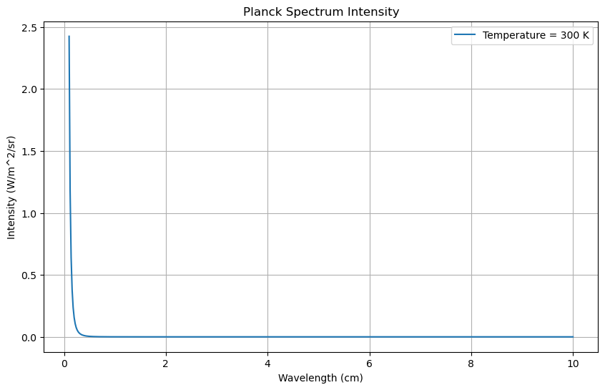

Slide 52
END – see jupter notebook for plancks project

